Slide 1

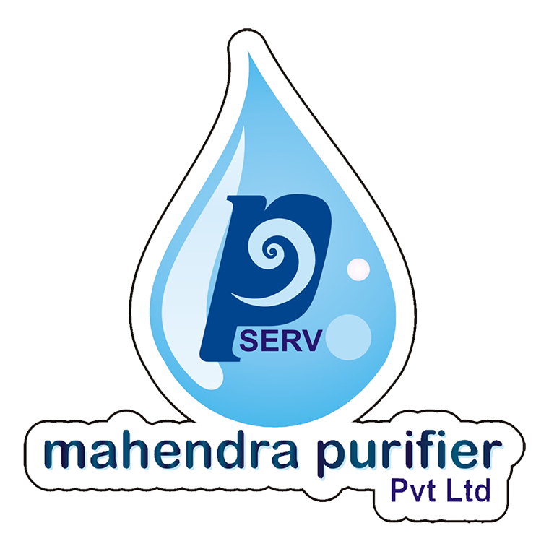
PRESENTS
Prisha Enterprises Nepal
Newroad Complex-3rd floor, Pokhara
Phone: 061-590633, 9849941660

Slide 2
Water
Chemical Formula – H₂0 ( Water Molecule contain two hydrogen and one oxygen atom.)
Liquid state of compound (Solid state- ICE, Gas phase - steam)
Water is tasteless, colorless and odorless
¾ of earth surface is coverd by water (like 71 % of earth surface)
Without food people can survive for a month but without water not more than a week
Water is most important nutrient to our body
Human body is water machine, evey life giving and healing process happens with water

Slide 3
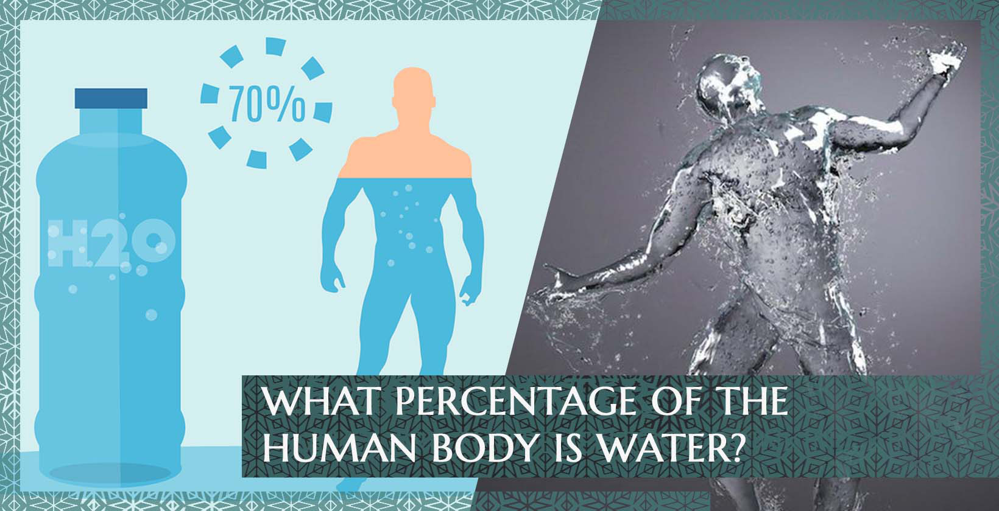

Slide 4
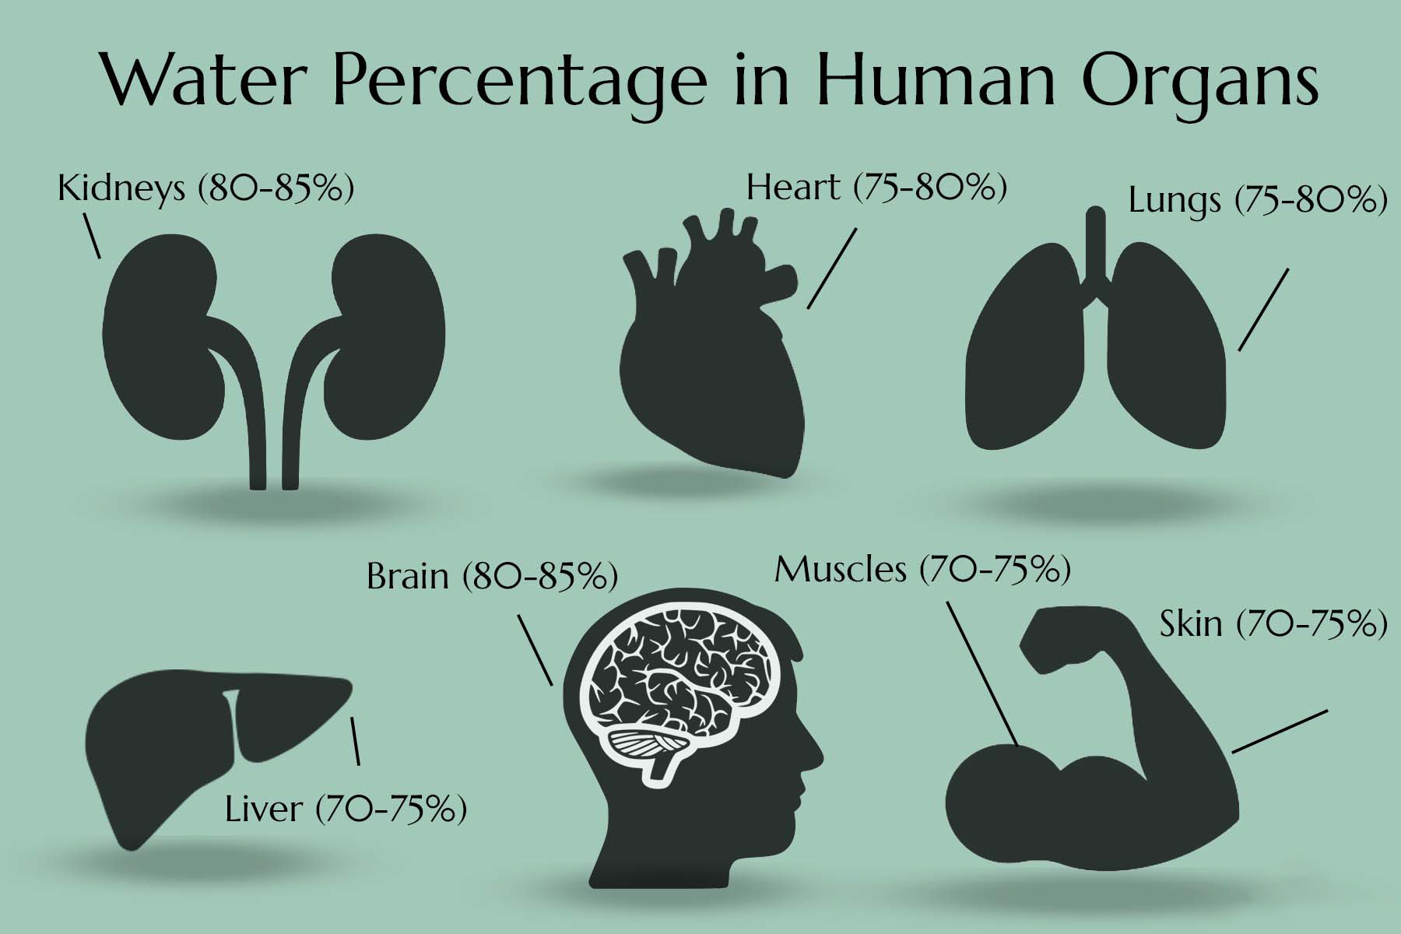

Slide 5
5 % drop in body fluid cause 25% to 30 % loss of energy.
3% water loss can result in health problem
15% water loss can result in death
2/3rd of human body is made up of water
Water and
Our Body

Slide 6
IMPURITY TYPE | CONTAINS | EFFECTS
PHYSICAL | DUST, MUD, STONE, LEAF | JAUNDICE, GAS, STONE
MICRO- BIOLOGICAL | BACTERIA, GERMS, VIRUSES | DIARRHOEA, HIGH FEVER, TYPHOID FEVER
CHEMICAL | ARSENIC, LEAD, COPPER, CALCIUM, IRON | CANCER, KIDNEY DAMAGES, BRAIN DAMAGE

Slide 7
Harmful chemical in water and its effects
LEAD- A metal found in natural deposits like in house hold plumbing material
In babies and children – Delays in physical and mental growth, slight deficits in attention span and learning abilities
In Adults – kidney problem and high blood pressure
ARSENIC- Occurs naturally in the environment and also as a by product of some agricultural and industrial activities.
Skin damage, problems in circulatory system, increased the risk of cancer in bladder, lungs, skin, kidney, nasal passages, liver and prostate

Slide 8
Coliform bacteria, Giardiasis, Cryptosporidiosis and Hepatitis A(1,2,3)
These micro-organism cause diseases like
Fever
Diarrhoea
Headache
Abdominal cramps
Nausea
Vomiting
Sickness

Slide 9
Technolgy to remove impurities from water
ULTRA VOILET(UV) TECHNOLOGY
Deactivated germs with the help of UV Rays
Unable to remove microbiological & chemical impurities
Only biological impurity is treated
ULTRA FILTRATION(UF) TECHNOLOGY
Type of membrane in which hydrostatic pressure forces a liquid against semi permeable membrane.
This technology can remove bacteria, virus and other oraganism up to 0.004 micron

Slide 10
Reverse Osmosis(R.O) Technology
RO is a process to remove dissolved inorganic solids from water
Membrane only allows to pass the water, not the impurities
Impurities are flushed down as a drain
Removes all sediments to a level of 0.0001 micron.
Removes all harmful elements such as arsenic, lead, dust, bacteria, virus etc.
Removes all types impurities like Physical, microbiological and chemical

Slide 11
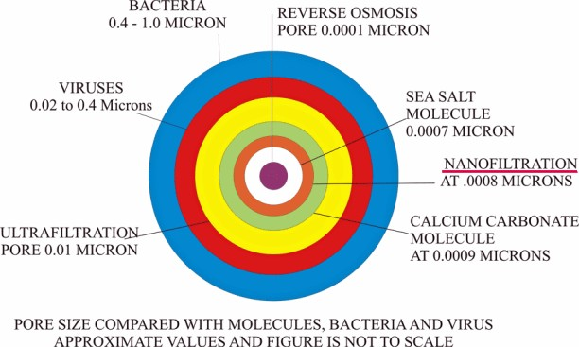

Slide 12

Human Body
and Water

Slide 13
About Mahendra Purifier:
Mahendra Purifier Pvt. Ltd, A pioneer of Water Purifier products and RO-based water purifying technology in Nepal, specializes in manufacturing and supplying water treatment solutions and water purification systems.
With the motto of providing consumers with a quality product at an affordable price, we have been in service since 2017 A.D.
Our company has been amplifying from Head office- Hetauda, Bhairav Complex, and corporate office from Civil Mall, Kathmandu along with over 25 branches stretching all over Nepal.

Slide 15

Our Products
Mud-Remover
Water Softener
Dialysis Water Plant
Mineral Water Plant
Water Purifier

Slide 16
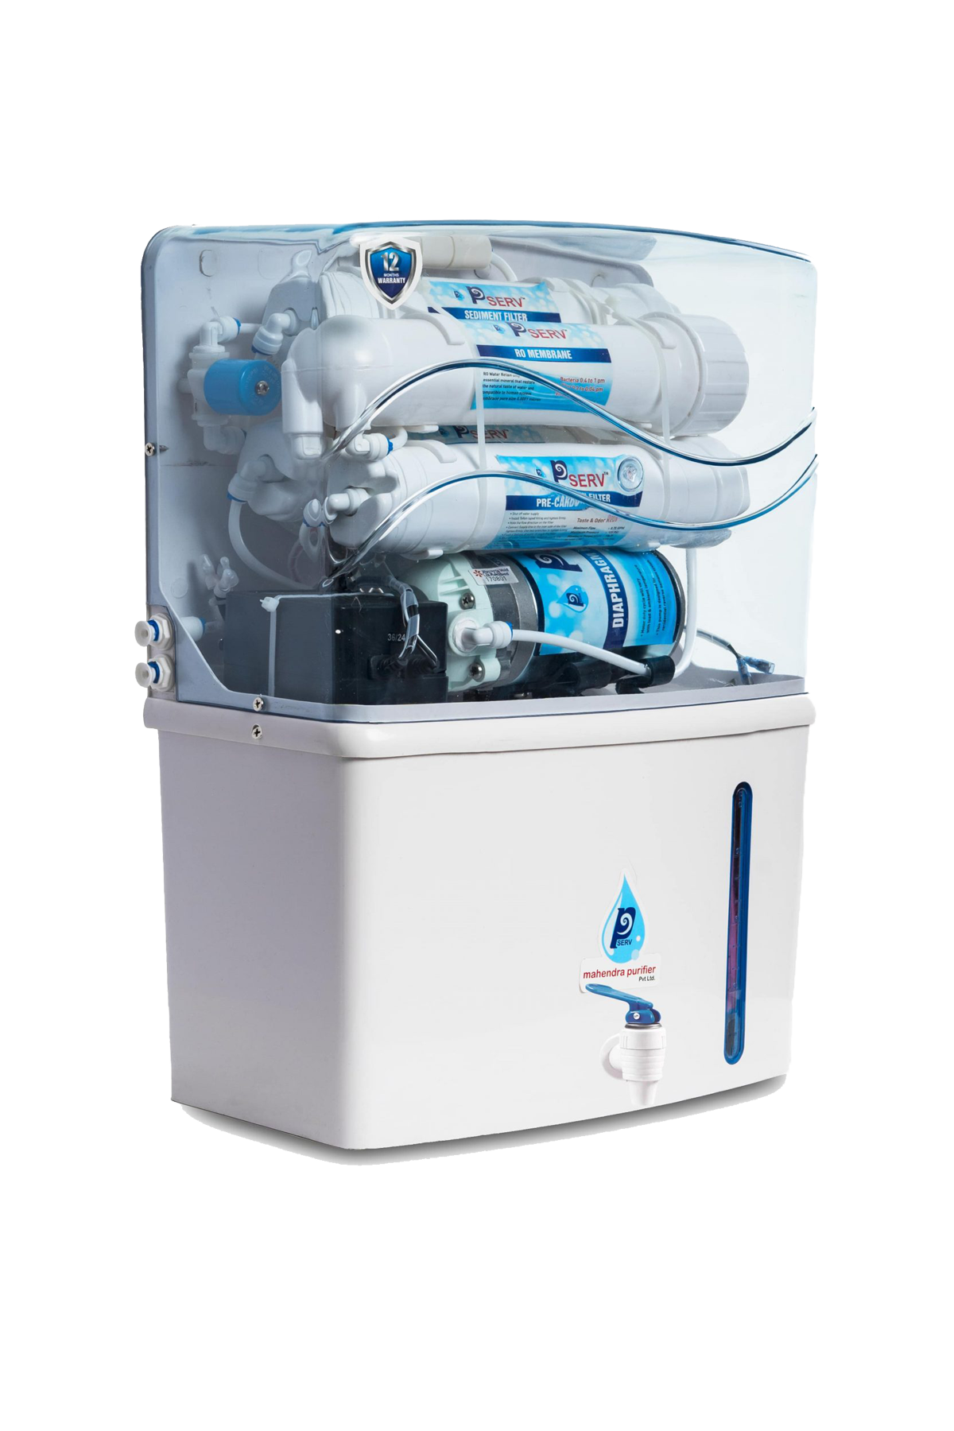
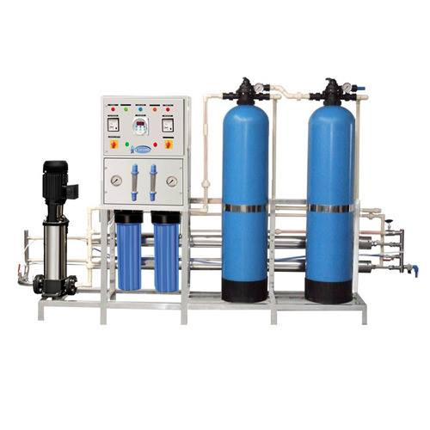
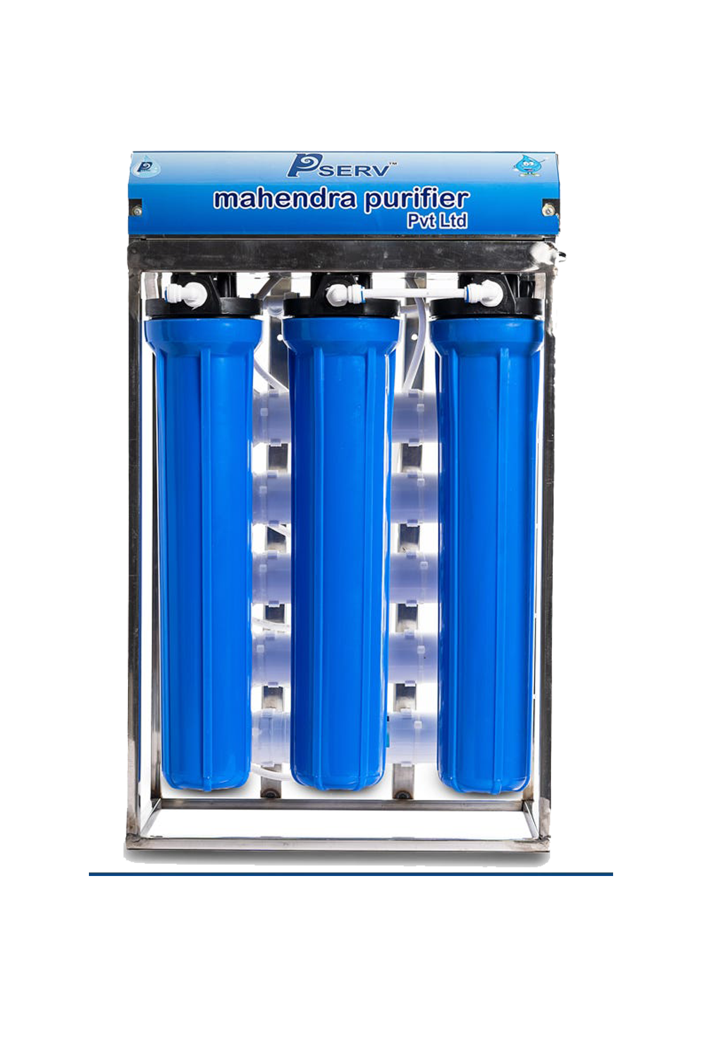
Our Plants
Domestic Plant
Institutional Plant
Industrial Plant

Slide 18
Our RO machine’s purifacation system
Sediment Filter: Removes physical impurities like dust, stone, mud ets.
Activated Carbon filter: Removes chlorine and some organic chemical impurities
Inline sediment: Removes physical impurities after carbon filtration process
RO Membrane: Removes all sediments to level of 0.0001 micron, removes all harmful chemical
Post Carbon: Removes bad odor

Slide 19
Quality Assurance
The company is continuously rising on the growth chart and setting high-quality standards.
All the finished goods are further inspected for any defects to ensure only the highest quality products reach our customers.
Our strict emphasis on quality is combined with the latest technology to manufacture world-class items.
We offer our customers the best that has resulted in providing a competitive edge over the others.

Slide 20

Certifications
Mahendra purifier’s awards are evidence of our prodigious reach and acceptance all over the country. We present you with the accolades received for our world-class technology and quality in our expedition so far:

Slide 21
Stage of Purification
This is the latest technology available in the market.
In this process we are forcing a solvent from a region of high solute concentration through a semipermeable membrane to a region of low solute concentration by applying a pressure in excess of the osmotic pressure.
It can effectively filter the water contained bacteria, viruses and all kinds of toxic chemical substances.
RO Technology

Slide 22
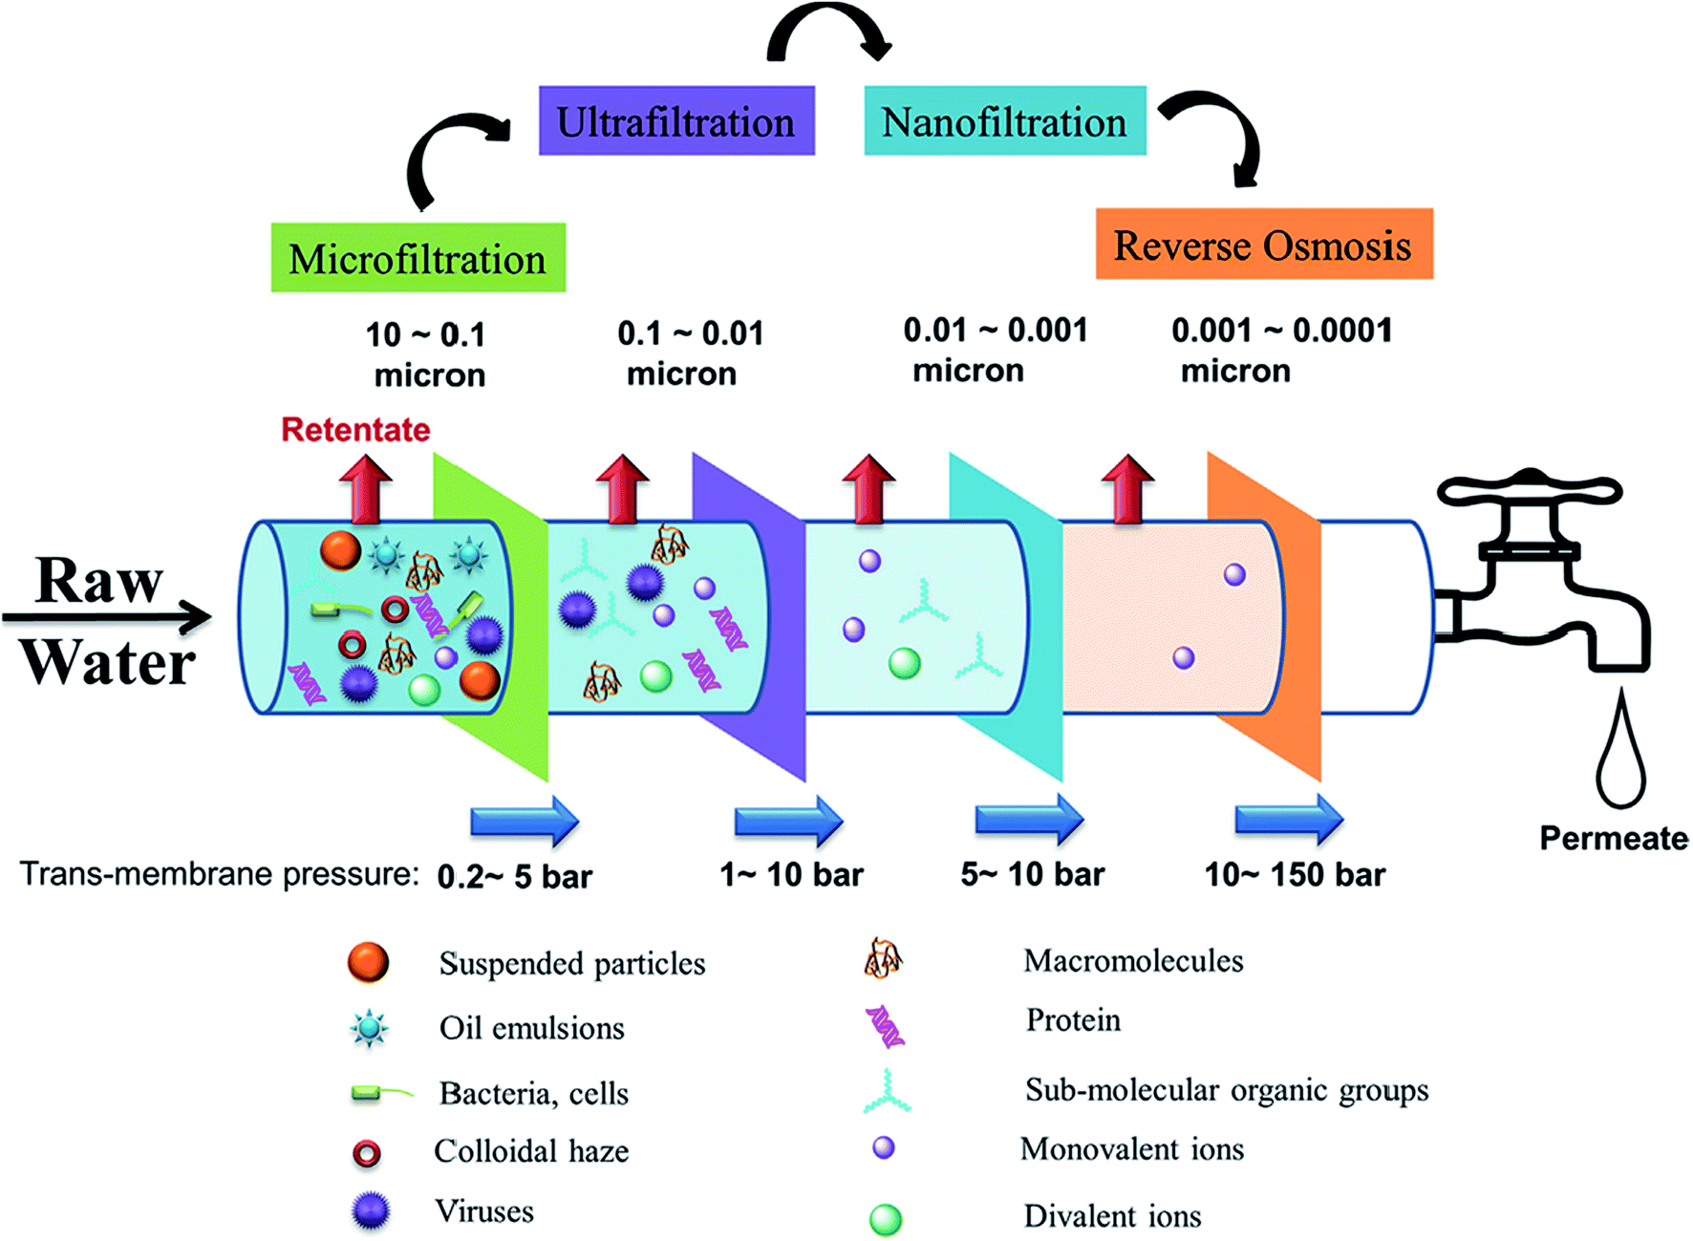

Slide 23
Reverse Osmosis water purification steps :
SEDIMENT FILTER:- Removes the physical impurities from water like dust, stone, mud etc.
ACTIVATED CARBON FILTER:- Removes chlorine and some organic chemical impurities from the water.
INLINE SEDIMENT:- This is similar to sediment filter. It removes the rest physical impurities which results after carbon filtration process means carbon particles.
RO MEMBRANE:- Removes all sediments to a level of 0.0001 micron. It removes all the harmful chemicals and elements from water.
POST CARBON:- After the full process of water purification the last step is post carbon. It removes the bad odor from the water and gives you clean water

Slide 24
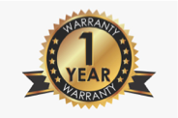



Key Attributes:
1 Year Warranty
Free Delivery & Installation
Free Lifetime Service
Free Routine Service

Slide 25
Our industrial Customer in Pokhara
Helmo Samaj Ghar at Chauthe – 100 Lph
New Light English Boarding School – 250 Lph
Gorkha Fitness Center – 250 Lph
Dhaulagiri Boarding School – 100 Lph
Nepal Ma Vi, Baglung - 100 Lph
Lekhnath Public School – 50 Lph
Jana Prakash higher Scondary School – 100 Lph
Laxmi Adarsha higher secondary school – 100 Lph and many more.

Slide 26

Any Questions ??

